Slide 1
TOPIC 13:
THERMAL PROPERTIES OF MATERIALS
Specific heat capacity
Specific latent heat
Internal energy
First Law of Thermodynamics

Slide 2
Kinetic Model of Matter
Kinetic model is based on the following assumptions:
i.) Matter is made up of tiny particles
ii.) These particles tend to attract each other
iii.) These particles tend to move about
3 states of matter that we must know is solid, liquid and gas. We describe their differences in term of 3 criteria:
i.) The spacing of the particles
ii.) The ordering of the particles
iii.) The motion of the particles
Generally, for most cases, when material changes from solid to liquid to gas, there is change from close spacing to greater spacing, from order to disorder, and from restricted motion to free, fast motion.

Slide 3
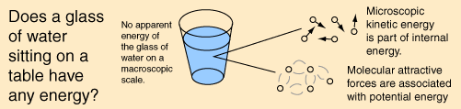
Internal Energy
According to the kinetic theory of matter, a body consist of particles that tend to attract / repel each other as they continually move about or vibrate about a fixed equilibrium positions.
The microscopic / internal potential energy is the total energy of all the atoms / molecules due to intermolecular forces, depending on their separation.
The microscopic / internal kinetic energy is the total energy of all the atoms / molecules due to their motion, depending on temperature.
Thus, the internal energy of a body is the sum of the microscopic potential and kinetic energies of the molecules in the body.

Slide 4
Internal Energy
U = P.E. + K.E
When 2 molecules are moved apart, their P.E. rises because work must be done against the attractive force between them.
When a body absorbs heat, the energy may be used to separate the atoms or molecules further thus increasing their potential energy.
Alternatively, the random motion of the atom or molecules may be increased by increasing the temperature of the body.
Thus, when the temperature of body rises, we can infer that the total microscopic K.E. of body has increase, and similarly the internal energy of the body has increased.
Not all molecules have the same kinetic energy, because they are moving with different speeds, but the sum of all the kinetic energies will be constant if the gas is kept at a constant temperature

Slide 5
Evaporation
Evaporation is the change of state of a liquid into its vapour, at any temperature.
The rate of evaporation depends on:
i.) the temperature of the liquid
ii.) the type of the liquid (oil, water, alcohol)
iii.) the surface area of the liquid
iv.) the movement of air above the surface of the liquid
Evaporation causes cooling of the liquid, which means the temperature of the liquid falls.
At any temperature, the molecules in a liquid are in continuous random motion. The more energetic molecules escape form the surface, leaving behind molecules with a below average kinetic energy.
Since temperature is a measure of the average kinetic energy of the molecules, it follows that the temperature of the evaporating liquid must fall.

Slide 6
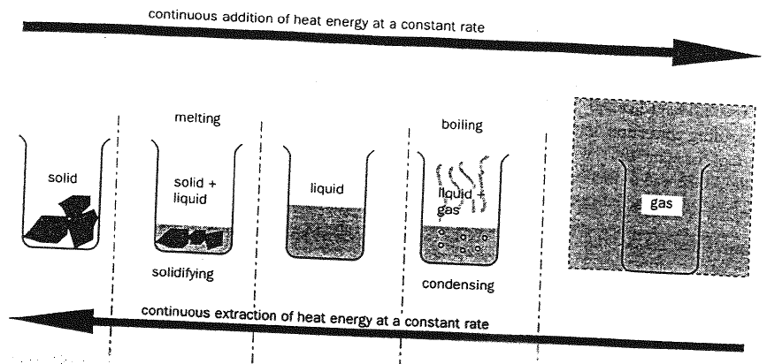
Heating of a Solid

Slide 7
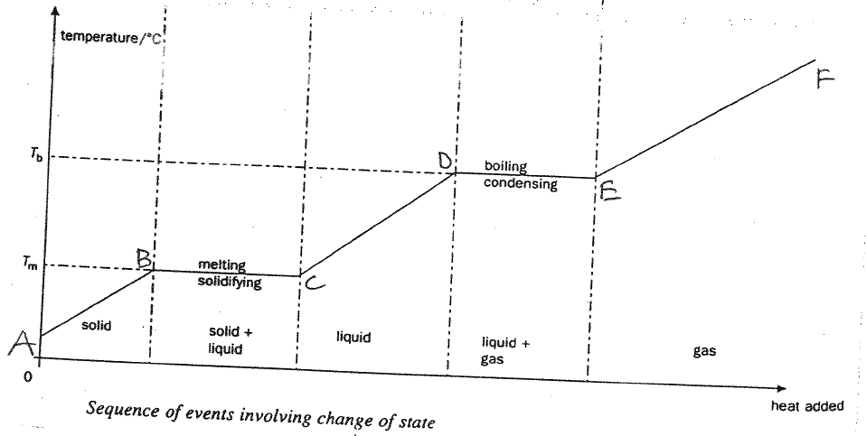
Heating of a Solid

Slide 8
Heating of a Solid
If the diagram is read form left to right, it shows a sequence of events when heat is continuously added to a solid.
Section AB – The solid temperature is well below its melting point. Heat supplied causes the temperature of the solid to increase until the melting point. Heat supplied increases the kinetic energy component of the internal energy so temperature rises. The mean molecular separation also increased slightly (solid expands) and this means a small increase in the molecular potential energy.

Slide 9
Heating of a Solid
Section BC – Once the melting point has been reached, continued heating does not cause any further increase in temperature until all the solid has melted. The heat supplied to cause the phase change from solid to liquid is called the latent heat of fusion.
The supply of latent heat increases the potential energy component of the internal energy by significantly increasing the mean separation of the molecules. Latent heat enables the molecules to overcome the force which holds them together in a regular crystalline lattice.
The solid structure then breaks down to give the greater molecular mobility and disorder of the liquid state. The kinetic energy does not increase so the temperature remains constant.

Slide 10
Heating of a Solid
Section CD – The solid become liquid. Its temperature rises towards the boiling point. The heat supplied increase the kinetic energy (mainly) and potential energy (slightly) of the liquid. Since kinetic energy increases, temperature also increases.

Slide 11
Heating of a Solid
Section DE – Once boiling point is reached, vaporisation occurs throughout the body of the liquid, not just from the surface. Continued heating from this point on does not cause any further increase in temperature.
The latent heat of vaporisation is the heat which is supplied at constant temperature to cause the phase change form liquid to vapour.
The latent heat of vaporisation is used in 2 ways which are to increase potential energy of the system by increasing the distance between the molecules and to do work by pushing the molecules in the atmosphere away as it expands.

Slide 12
Heating of a Solid
Section EF – Continued heating of the gas, once all the liquid has evaporated, will again produce a rise in temperature.
Heat supplied increases the kinetic energy of the gas so the temperature increases.

Slide 13
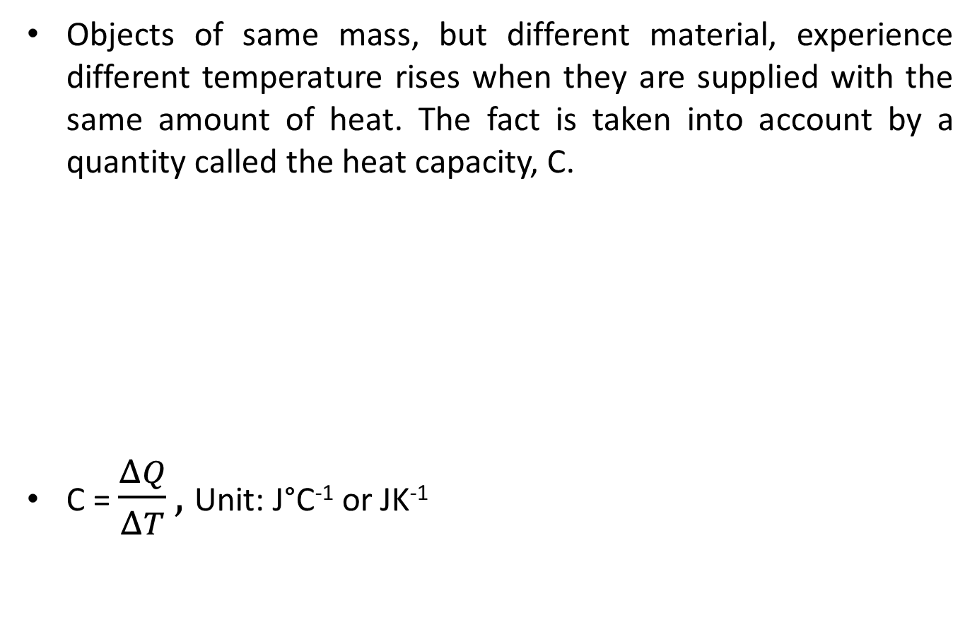

Heat Capacity
Defined as the amount of heat required (∆Q) to raise the temperature of an object by 1°C or 1 K

Slide 14
Example 1:
The air in a meeting room has a heat capacity of 1.3 x 10⁵ J°C⁻¹. How much heat energy must be removed by the air conditioning system to reduce the temperature in the room by 3°C?

Slide 15
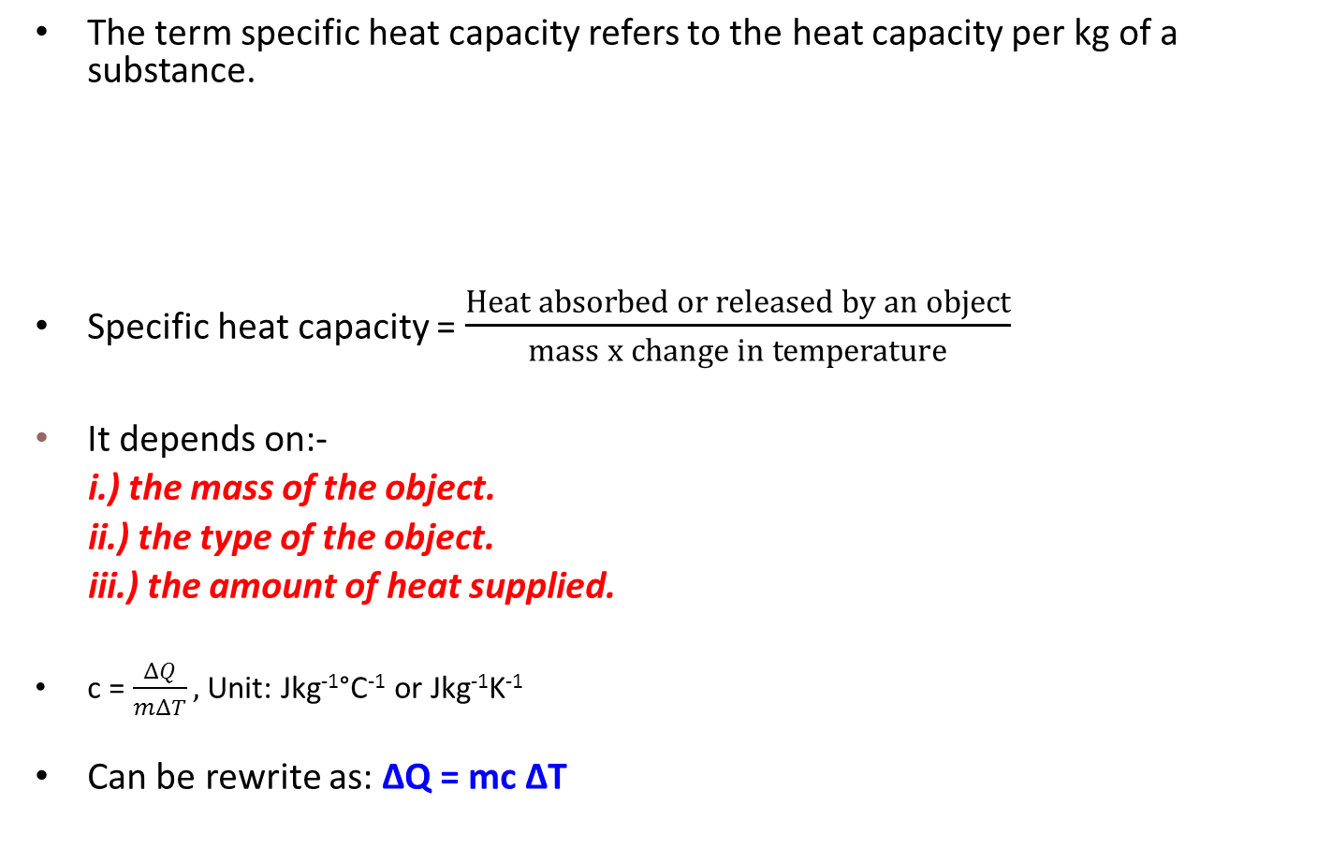
Specific heat capacity
Defined as the amount of heat required (∆Q) to raise the temperature of an object by 1°C or 1 K in 1 kg of substance

Slide 16
Substance | J/kg/ºC or J/kg/K
Water (0 ºC to 100 ºC) | 4186
Methyl Alcohol | 2549
Human Body | 3470
Ice (-10 ºC to 0 ºC) | 2093
Steam (100 ºC) | 2009
Air (50 ºC) | 1046
Aluminum | 900
Marble | 858
Glass (typical) | 837
Iron/Steel | 452
Copper | 387
Silver | 236
Mercury | 138
Gold | 130
Lead | 128
Values of specific heat capacity of some substances

Slide 17
Example 2:
Liquid X of mass 2kg require 3800J of heat to raise its temperature by 10˚C.
State the specific heat capacity of liquid X
Calculate the total thermal energy required to raise the temperature of 1kg of liquid X by 3˚C.

Slide 18
Example 3:
8kg of water is allowed to cool after reaching its boiling point. Given that the specific heat capacity, c of water is 4200 Jkg⁻¹˚C⁻¹, calculate the final temperature of the quantity of water after 480kJ of heat has been released

Slide 19
Example 4:
160g of a liquid X is prepared at room temperature, 27˚C. Then, 250g of pure water at its boiling point is poured into the beaker of the liquid X. What is the final temperature of the mixture.
(specific heat capacity of water = 4200 Jkg⁻¹˚C⁻¹ )
(specific heat capacity of liquid X = 500 Jkg⁻¹˚C⁻¹ )

Slide 20
Example 5:
A water tank contains 120 kg of water at 15°C. The tank itself has a heat capacity of 6000 J K⁻¹. Find how long it will take an immerse heater to raise the temperature of the water to 50 °C if the tank is well insulated and the power of the heater is 2500 W.
(specific heat capacity of water = 4200 Jkg⁻¹˚C⁻¹ )

Slide 21
Main principles of determination of specific heat capacity by electrical methods
Can be determined if
  The mass of the material is known
  The increase in temperature of the material is known
  The power of the heater used is known
  The energy input is determined from ΔQ = Pt and then equated to mcΔT.

Slide 22
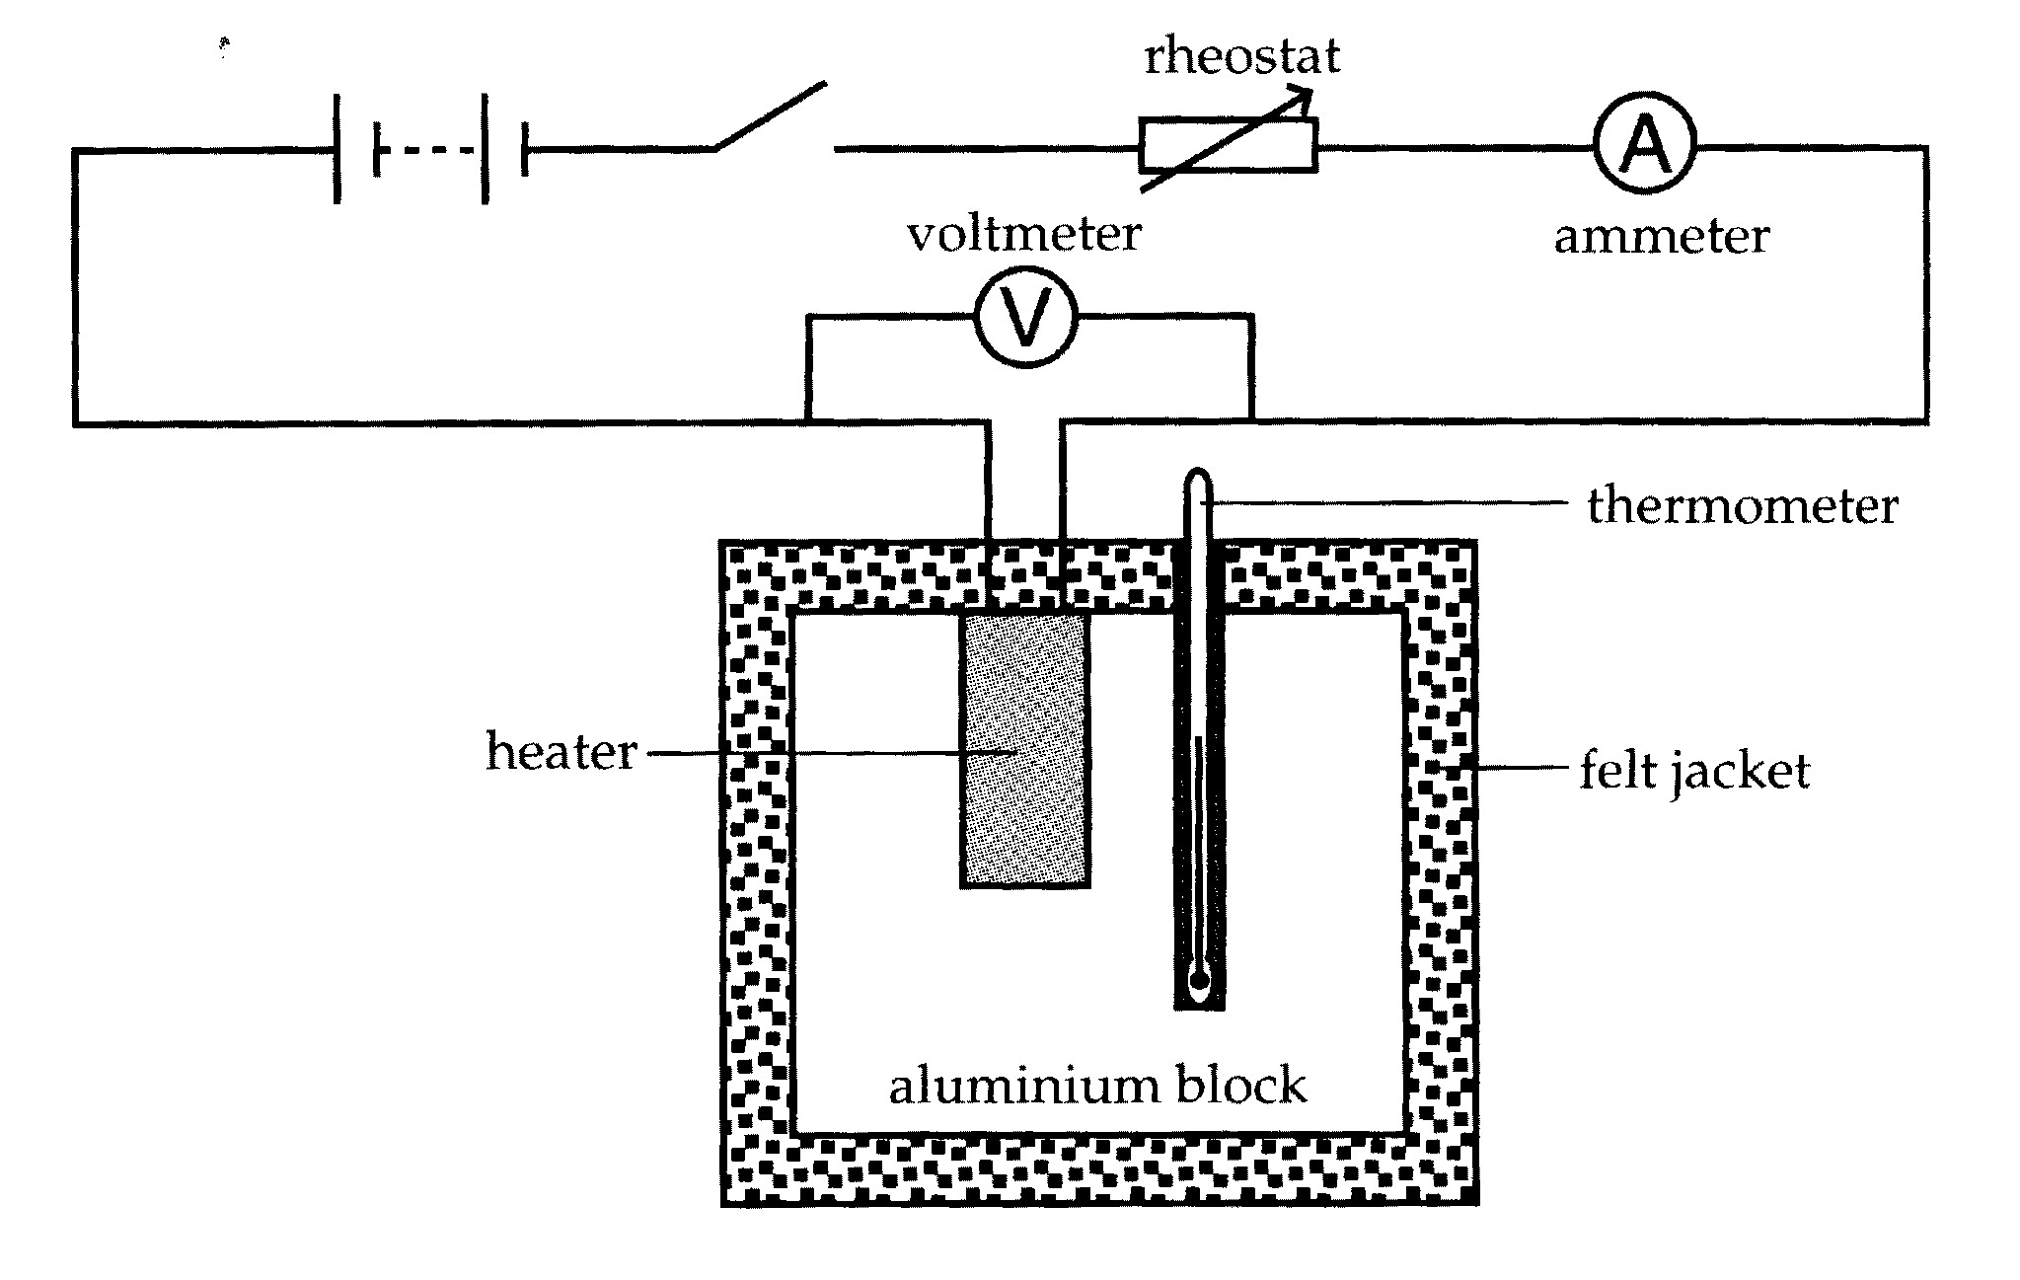
Determination of specific heat capacity of solids

Slide 23
Determination of specific heat capacity of solids
The experimental set up is shown in the diagram.
An immersion heater and the thermometer is placed in the hole of a cylindrical aluminum block of the known mass, m.
The block is well insulated with expanded polystyrene so as to minimise heat loss to surroundings. Oil may be used in the holes to give good thermal contacts between the heater and the metal of the block and between the thermometer and the metal of the block.
Initial temperature, T₁ is recorded.
A steady current is then switched on and the stopwatch started at the same time. Voltmeter reading V and ammeter reading I are recorded.
Record values of temperature, T as it rises and plot a graph of temperature against time, t.

Slide 24
Determination of specific heat capacity of solids
From equation of Q = mc ∆T, divide both sides by time interval, ∆t:
Q / ∆t = mc (∆T / ∆t)
whereby the quantity Q / ∆t is the rate at which energy is supplied, i.e. the power of the heater.
The quantity ∆T / ∆t is the rate of rise of temperature of the block, i.e. the gradient of the graph of temperature vs time.
Hence, Q / ∆t = mc ( ∆T / ∆t ) becomes
P = mc (gradient) ; where P = VI
Thus, c = (V x I)/ (m x gradient)
- assuming there is negligible heat loss to surroundings.

Slide 25
Example 6
In an experiment to measure the specific heat capacity of water, a student used an electrical heater to heat some water. His results are shown below. Calculate the value for the specific heat capacity of water. Comment on any likely sources of error.
mass of beaker = 150 g mass of beaker + water = 672 g
current in the heater = 3.9 A p.d. across heater = 11.4 V
initial temp = 18.5 ˚C final temp = 30.2 ˚C
time taken = 12 mins

Slide 26
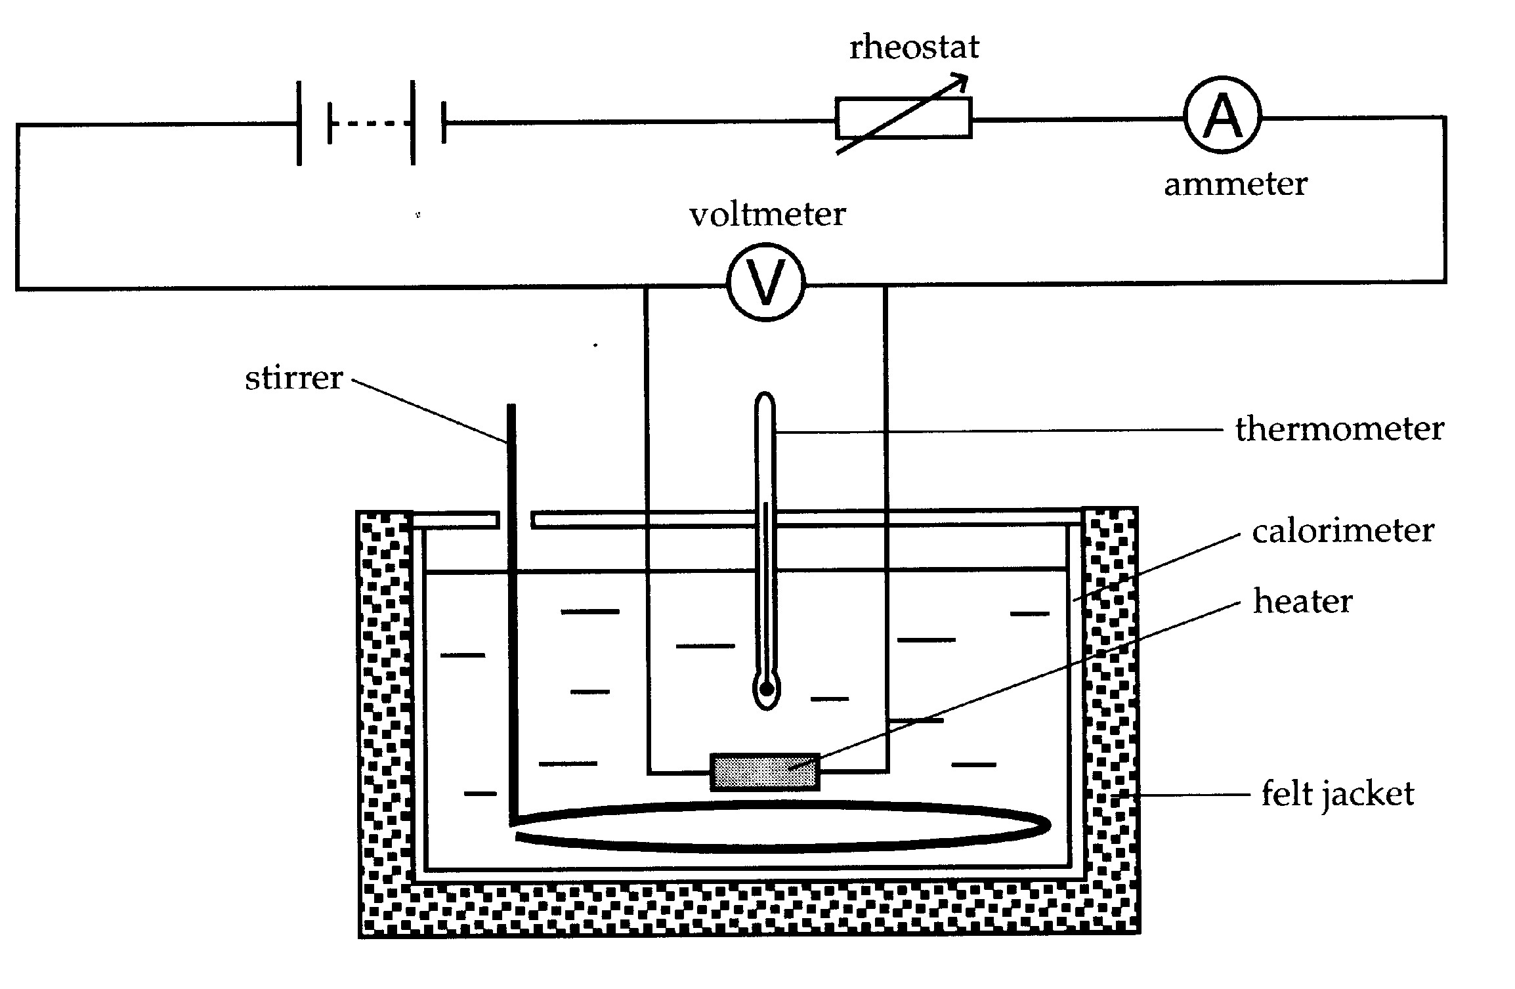
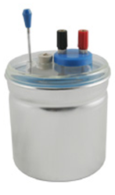
Determination of specific heat capacity of liquids

Slide 27
Determination of specific heat capacity of liquids
The experimental set up is shown in the previous diagram.
The liquid contained in a polished copper or aluminium can called a calorimeter which is suitably insulated to minimise heat loss.
The heating is provided by a heating coil which is totally immersed in the liquid under test.
The procedure is very similar to that for the solid, except that the liquid must be stirred continuously during the experiment.
A temperature rise, ∆T is produced in the liquid by heating it for a time, t.

Slide 28
Determination of specific heat capacity of liquids
If I, V = heater current and p.d.
m = mass of the liquid
m_{c} = mass of the calorimeter
c_{c} = specific heat capacity of the calorimeter
Then, assuming negligible heat loss to the surroundings:
(energy supplied by the heater) = (energy gained by liquid) + ( energy gained
by calorimeter)
Hence we have:
VIt = mc∆T + m_{c}c_{c} ∆T ; thus c can be calculated if c_{c} is known.

Slide 29
Latent heat (hidden heat)
The latent heat of fusion refers to the heat absorbed by a solid when it undergoes a solid to liquid phase change (i.e. melting) at its constant freezing (or melting) point temperature. (in Joule)
The latent heat of vaporization refers to the heat absorbed by a liquid when it undergoes a liquid to vapor phase change (i.e. boiling) at its constant boiling (or condensation) point temperature. (in Joule)
During melting or boiling, heat supplied to molecules is used to weaken or break the intermolecular bonds. This increases their potential energy. They are free to move about. The intermolecular spacing increases, and density decreases.

Slide 30
Specific Latent heat
The specific latent heat of fusion refers to the heat required per unit mass of a substance to change its state from solid to liquid without any change in temperature.
The specific latent heat of vaporization refers to the heat required per unit mass of a substance to change its state from liquid to vapor without any change in temperature.
For a change of state in the reverse direction (i.e. liquid to solid, vapor to liquid,) ∆Q is the amount of heat extracted from the source.
∆Q = mL ; L = specific latent heat ; Unit: Jkg⁻¹
Generally, the specific latent heat of vaporization is greater than specific latent heat of fusion.
i.) This is because a change of state from liquid to gas results in a large increase in volume (intermolecular separation greater), therefore requires large increase in potential energy of the molecules. Thus greater specific latent heat is required for vaporization compared to fusion.
ii.) Besides that, more work also has to be done to expand against the pressure of the atmosphere since expansion in volume is greater for liquid to gas state.

Slide 31
Example 7:
How much heat is needed to change the state of matter of 250 g of ice to water at 0⁰C? [L_{f} = 3.36 x 10⁵ Jkg⁻¹]

Slide 32
Main principles of the determination by the electrical methods of the specific latent heat of fusion/vaporisation
Can be determined if:
  The mass of the material
  The power of the heater used are known
  the energy input is determined from ΔQ = Pt and then equated to mL_{f} or mL_{v}.

Slide 33
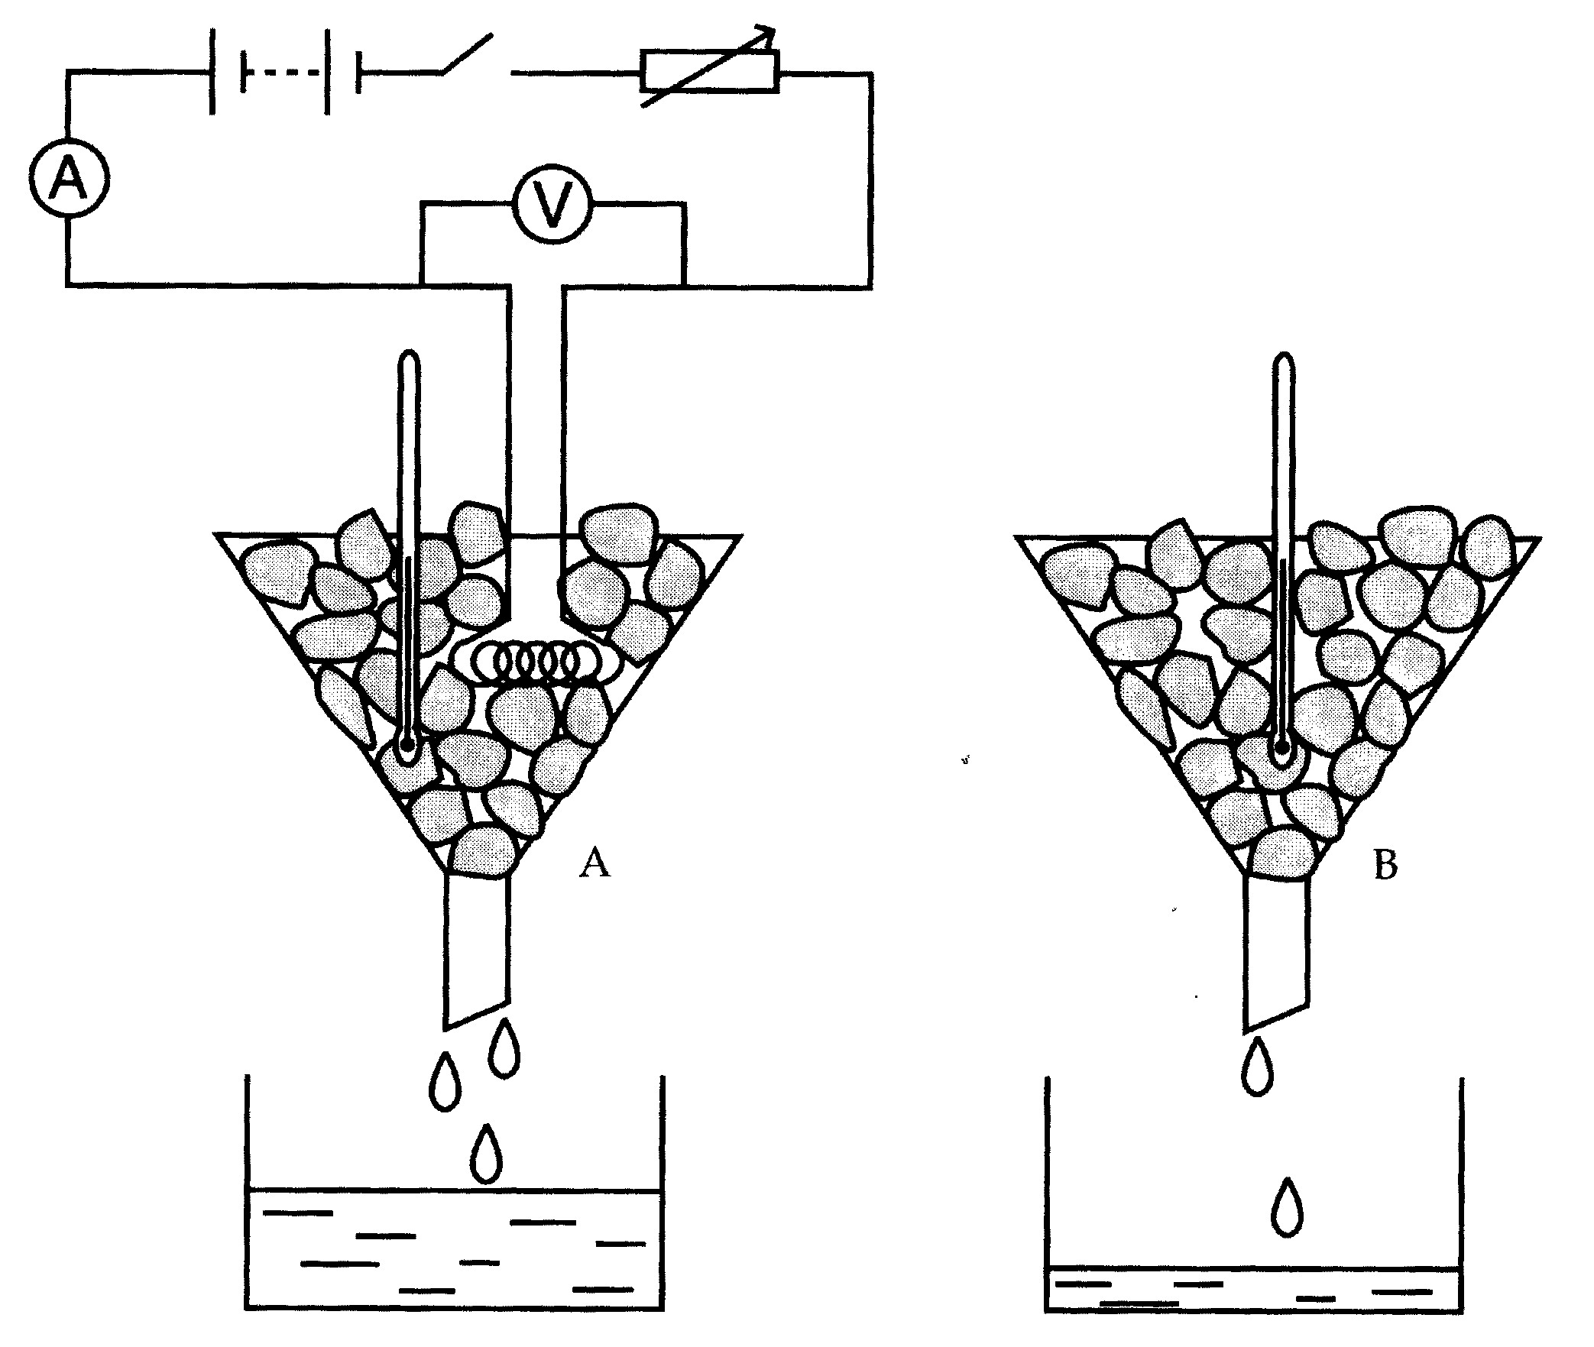
Determination of specific latent heat of fusion

Slide 34
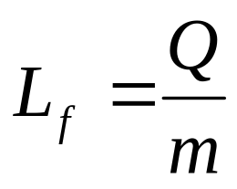
Determination of specific latent heat of fusion
A heater is connected to power supply is immersed in ice at 0°C in funnel A.
When a steady current is switched on, stopwatch is started at the same time.
After a time t , the mass of melted ice (m₁) is collected in a beaker and is determined.
A control set is set up side by side with funnel A.
This is to determine the mass of ice (m₂) that will melt in time t at room temperature.

Slide 35
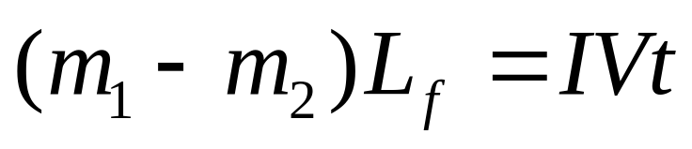
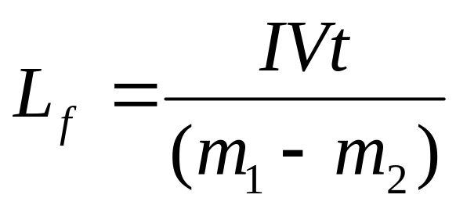
Determination of specific latent heat of fusion
Thermal energy needed = electrical energy given to melt the ice out by the heater

Slide 36
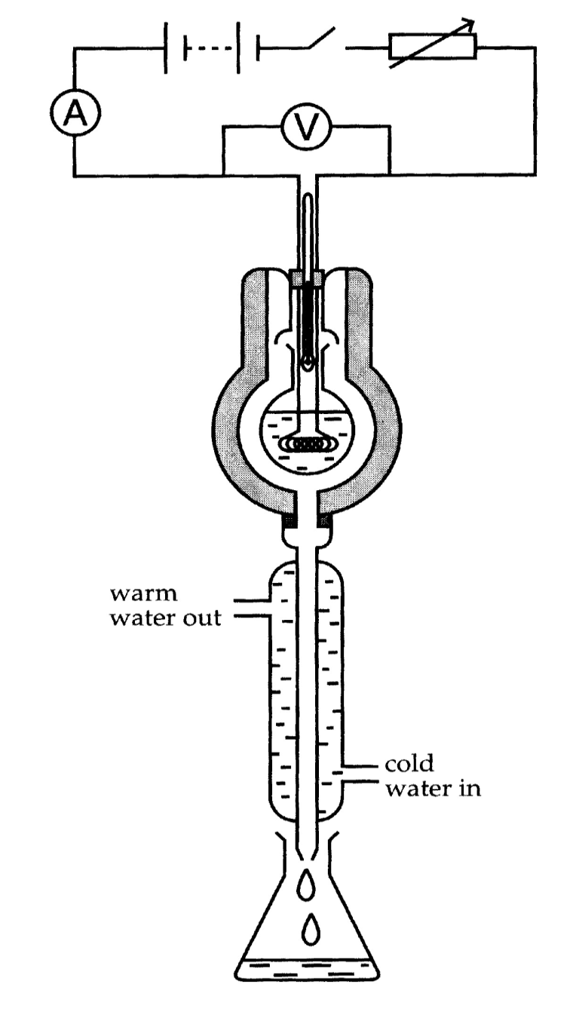
Determination of specific latent heat of vaporization
The liquid under test is electrically heated by a coil carrying a steady current (I₁) and having a p.d. (V₁) across it.
When the liquid boils, the vapour which is produced passes through holes in the inner wall of the container into the condenser.
Boiling is continued until the temperature of all parts o the apparatus have steadied.
The condensed vapour is then collected over a measure time interval (t) and its mass (m₁) is measured.

Slide 37
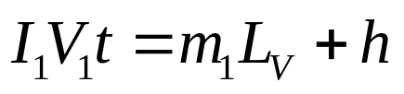
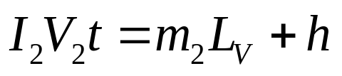
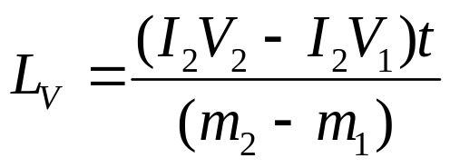
Determination of specific latent heat of vaporization
Electrical energy supplied = latent heat of vaporization + heat loss to surroundings
Using a new heater current and p.d. (I₂ , V₂) the new mass (m₂) of vapour which condenses in the same time (t) is measured. Then ,
(2) – (1) ;
-- (1)
-- (2)
heat loss, h is same in this case since temperature of liquid remain unchanged.
(at boiling point)

Slide 38
Example 8:
Calculate the amount of heat required to completely convert 50 g of ice at 0 ºC to steam at 100 ºC.
The specific heat capacity of water is 4.18 kJ kg⁻¹ K⁻¹
The specific latent heat of fusion of ice is 334 kJ kg⁻¹
The specific heat of vaporization of water is 2260 kJ kg⁻¹
If a constant power supply of 2400 W is supplied, calculate the time needed for this whole process?

Slide 39
Example 9:
An immersion heater supplies heat at a rate of 5 Js⁻¹ to an insulated vessel containing a certain liquid. The liquid was brought to its boiling point and kept boiling for 2 minutes, during which time the liquid lost 4.0 g. What value for the specific latent heat of vaporization of the liquid can be calculated from this experiment?

Slide 40
The First Law of Thermodynamic
Is the study of the relationship between the heat, internal energy and mechanical work of thermodynamic systems.
Any system can exchange energy with its surrounding in 2 general ways:
The internal energy of the system changes in magnitude as heat is added or removed from the system, or as work is done on it or by it.
As heat
As work

Slide 41
The First Law of Thermodynamic
Is the application of the conservation of energy
This law states that the sum of the increase in internal energy of the system
is equals to the heat supplied and external work done on the system
ΔU = ΔQ + ΔW
The internal energy of the system changes in magnitude as heat is added or removed from the system, or as work is done on it or by it.
Increase in internal energy
Energy supplied by doing work on system
Energy supplied by heating

Slide 42
The Importance of Sign Convention
 | + (positive) | - (negative)
∆U | INCREASE in internal energy | DECREASE in internal energy
Q | Heat SUPPLIED TO the system | Heat LOSS BY the system
W | Work done ON the system | Work done BY the system

Slide 43
Example 10:
2500 J heat is added to a system and 1800 J of work is done on the system. What is the change in internal energy of the system?
The system gain 1500 J heat and 2200 J work is done on the system by the surrounding. Determine the change in the internal energy of the system.

Slide 44
Example 11:
After absorbing 2.85 kJ, an ideal gas expands and does mechanical work of 0.15 kJ. Determine the change in internal energy of the gas.

Slide 45
Example 12:
A fixed mass of an ideal gas absorbs 1000 J of heat and expands under constant pressure of 20 kPa from a volume of 25 x 10⁻³ m³ to a volume of 50 x 10⁻³ m³. What is the change in internal energy of the gas?

